Slide 1


World University Ranking Analysis
By
Bhavya Kavuri
Dhruva Kiran Veeravalli
Aditya Gidda
Jaswanth Das Gunturu

Slide 2
Introduction
World University Rankings 2016 by Times Higher Education(THE).
Source : https://goo.gl/gDsdZL
Objective : Train the first 150 Ranked universities and predict the ranks for the next 50.
Multiple Linear Regression in R.

Slide 3
Exploratory Data Analysis
Variables used | Description
World_rank | Contains the world rank for the university
University_name | Name of the university
Country | Country of each university
Teaching | University score for teaching
International_outlook | University score international outlook(Staff, Students, Research)
Research | University score for research
Citations | University score for citations
Income | University score for industry income
Total_score | Total score for university used to determine the rank
Num_students | Number of students at the university
Student_staff_ratio | Number of students divided by number of staff
International_students | Percentage of students who are international
Female_male_ratio | Female student to male student ratio

Slide 4
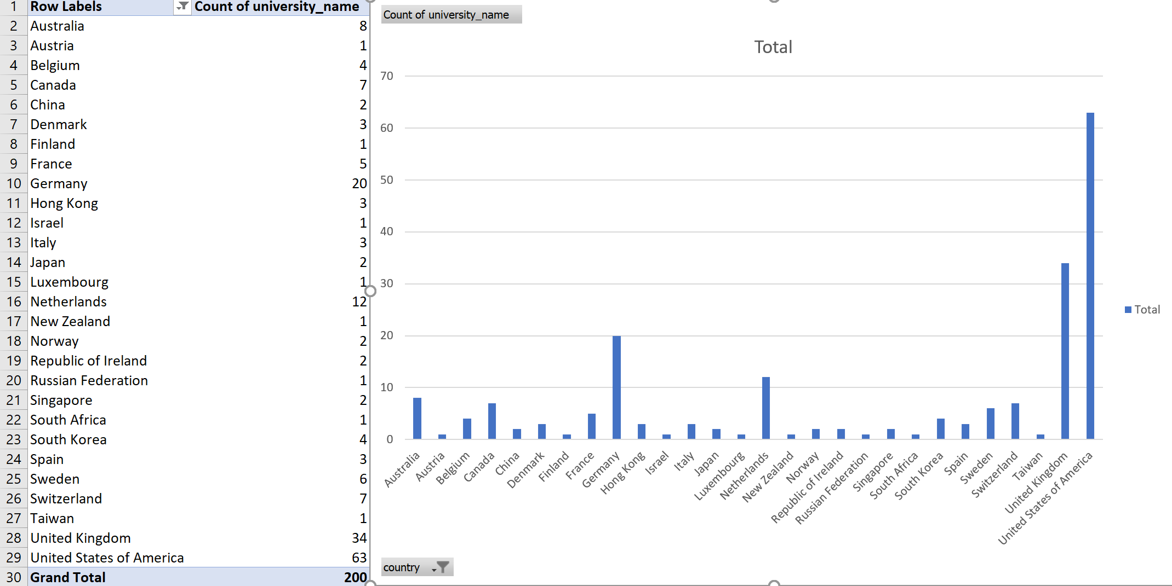
Exploratory Data Analysis

Slide 5
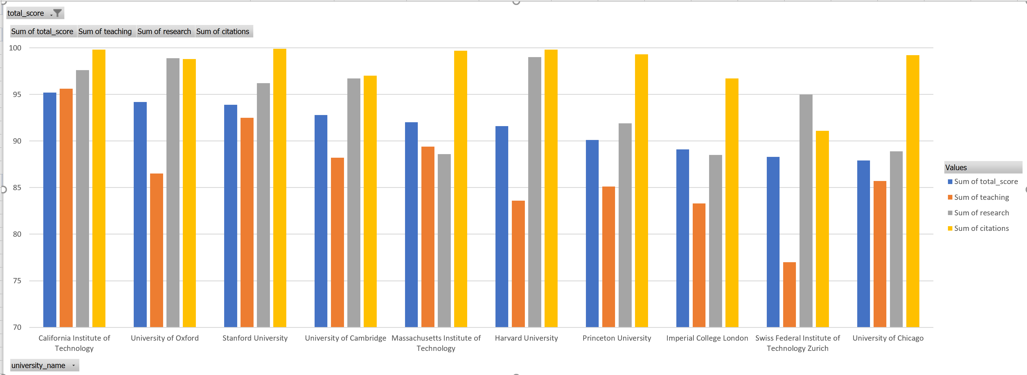
Exploratory Data Analysis

Slide 6
Exploratory Data Analysis
Cleaning the data
Data | Transformation
International_Students | Removed “%”
Num_students | Removed “,”
Income | Removed “-”
Female : Male | Converted to % of female students

Slide 7
Exploratory Data Analysis
Data Imputation
Missing Data
Income – 2.5%
Num_students – 1%
Student_Staff_ratio – 1%
International_students – 1%
Female_students – 12.5%
Outliers
We’ve found about 10 outliers and the imputation is done in the same way as in missing data.

Slide 8
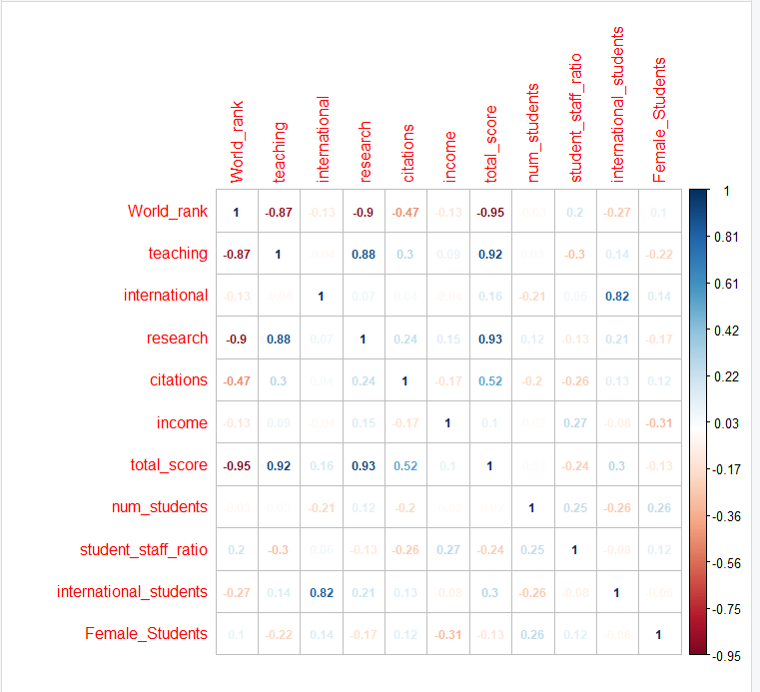
Correlation Matrix
International_Students is highly correlated to International_outlook.
Research is correlated to teaching.
World_rank and Total_score are each highly correlated to Teaching, research and citations.

Slide 9
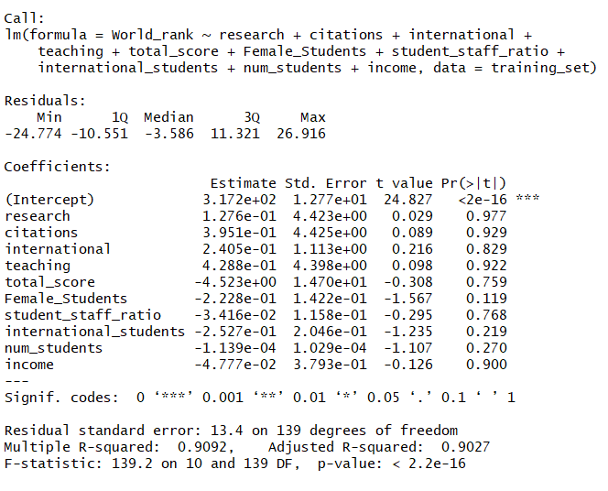

Multiple Linear Regression with World Rank

Slide 10
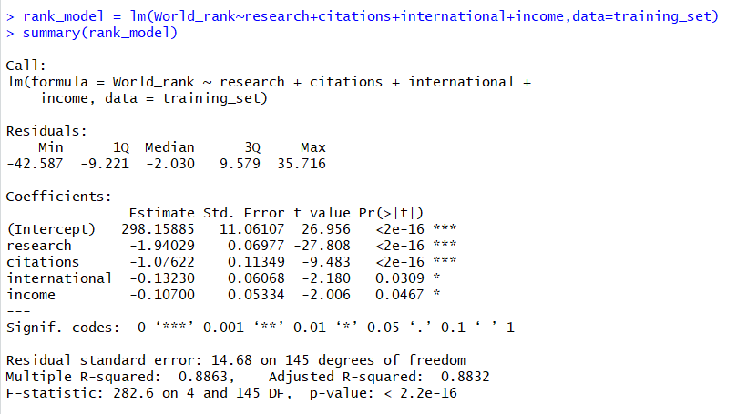

Improved Regression Model
> vif(rank_model)
VIF
Research | 1.112233
Citations | 1.119029
International | 1.008162
Income | 1.084177

Slide 11
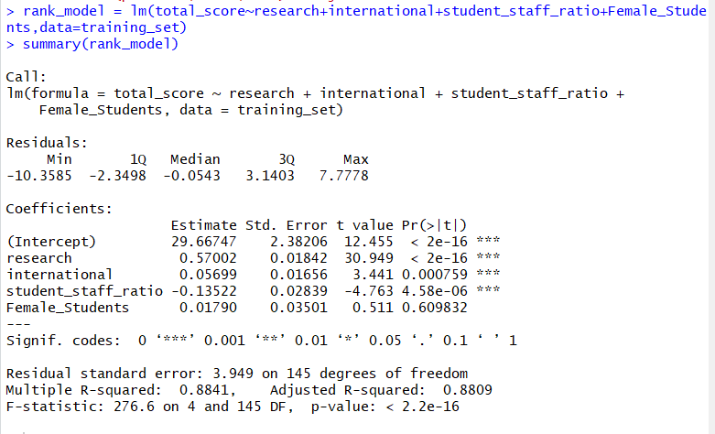
Regression with Total_Score

Slide 12
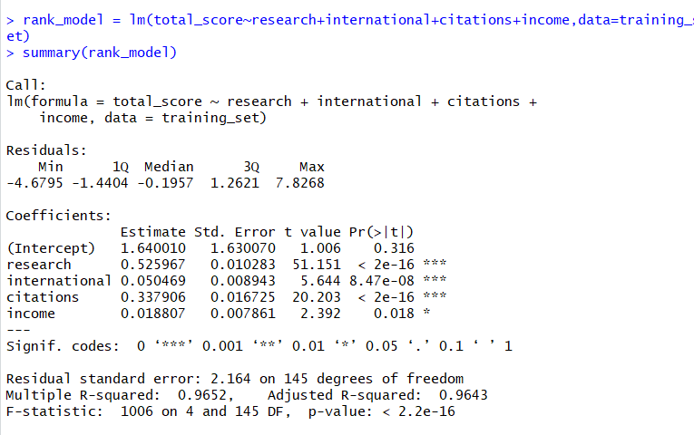
Final Regression Model

Slide 13
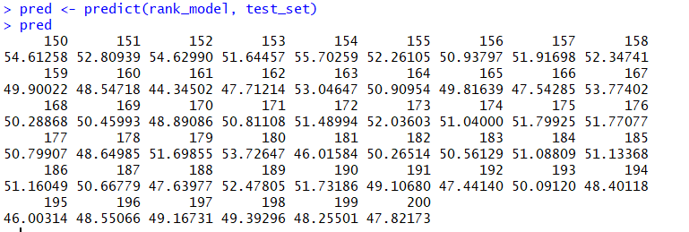

Prediction

Slide 14
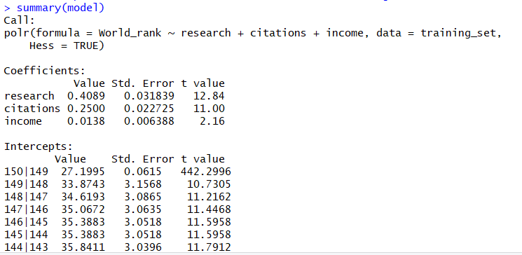
Ordinal Regression
Performed on models for predicting an ordinal variable like rank

Slide 15
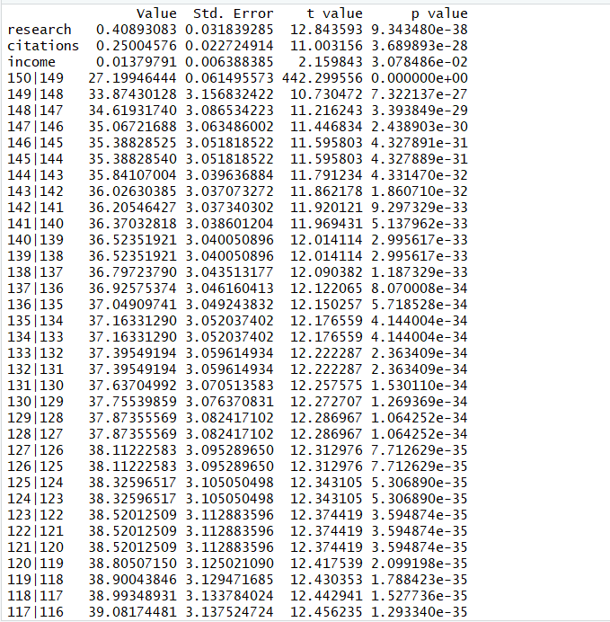
Ordinal Regression

Slide 16
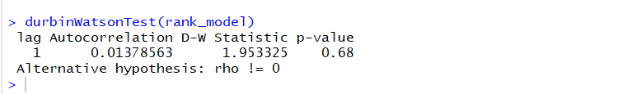
Durbin Watson Statistic Test
Multi Collinearity

Slide 17
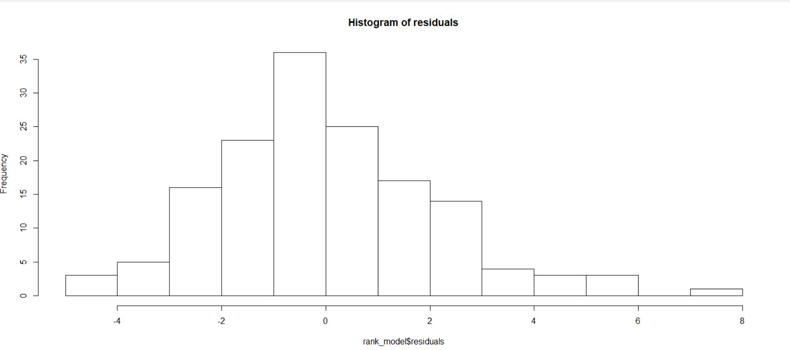
Histogram

Slide 18
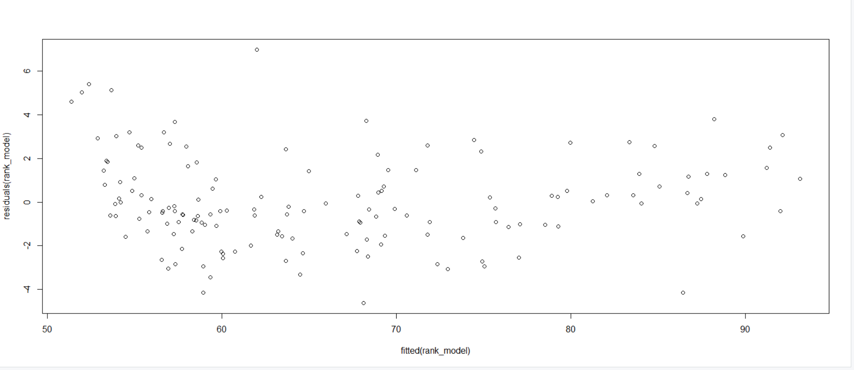
Constant Variance

Slide 19
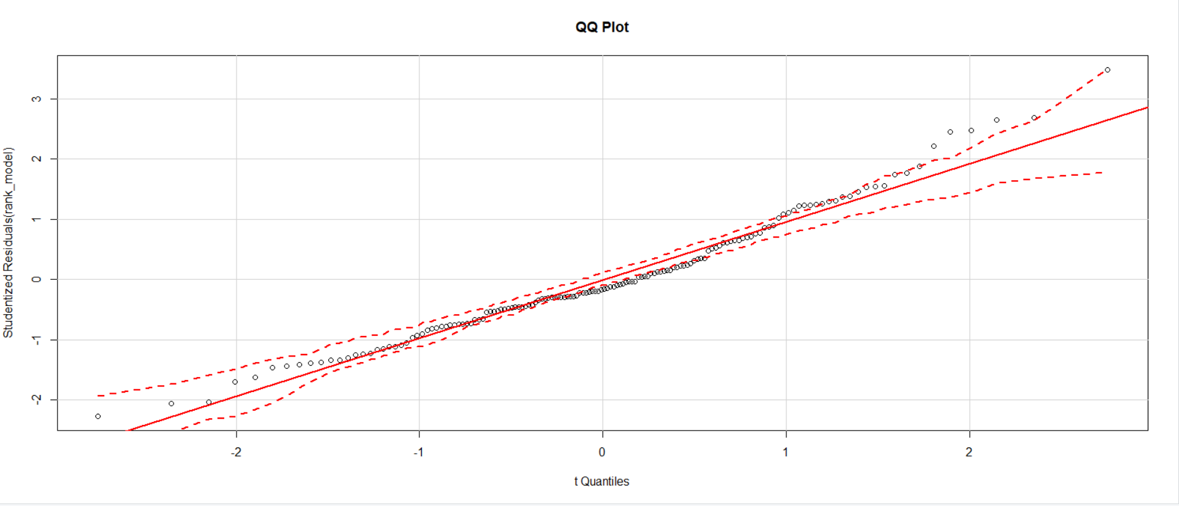
QQ Plot

Slide 20
Thank You

